Slide 1
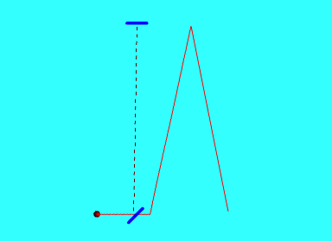
CAUSE of the mechanical and electromagnetic equivalency of inertial systems
MICHELSON EXPERIMENT ANALOGY
Elastic Scattering

Slide 2
Beyond the phenomenology of special relativity
Special relativity stipulates the equivalency (mechanical as well as electromagnetic) of inertial systems. It is its starting point. There is no causal justification, it is just a phenomenological standpoint.
The equivalency of inertial systems is stated in the first postulate: “The physical laws of nature are the same in every inertial frame of reference”.
But what makes inertial systems to behave identically, independently of their motion, whenever linear and constant? Is this a primordial property, or is there an underlying cause that makes them equivalent?
Here, beyond the phenomenology of special relativity, the cause of equivalency is quested.

Slide 3
First and second order equivalency of inertial systems
First order equivalency: mechanical and ray optic equivalency (on the following animations the impinging object can equivalently be a ball or a photon)
Second order equivalency: electromagnetic equivalency (interferometric invariance)

Slide 4
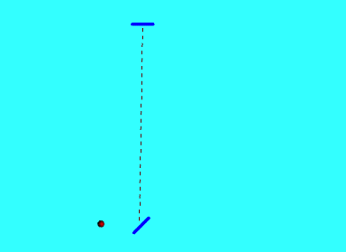
First order equivalency of inertial systems

Invariance of the observed beam path
Fig.1a: Actual path of the beam Fig.1b: Observed path on the inertial system

Slide 5
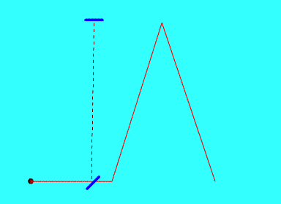
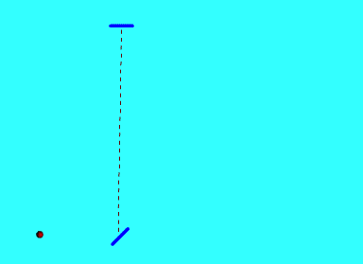
Two different kinematic scenarios, with different relative speed. Still, in both cases on each inertial system the ball path appears identical

Slide 6
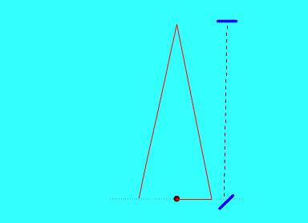
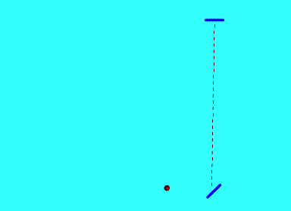
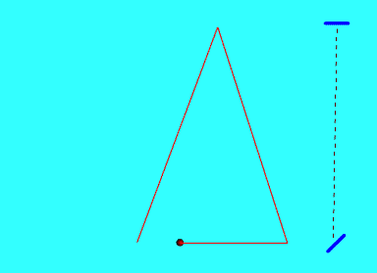
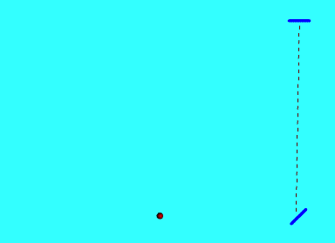
Two other kinematic scenarios, in which the ball and the system move in opposite directions. On the inertial systems the ball path still appears identical

Slide 7
Ball and system are moving in the same direction, with respective speed v₁ and v₂ Their relative speed is: δ₁ = v₁- v₂
Ball and system are moving in the same direction, with respective speed v₃ and v₄ Their relative speed is: δ₂ = v₃- v₄

Slide 8
Speed-induced deflection of the incident beam
The deflection angle α is proportional to the speed of the inertial system and that of light
sin(α) = v / c
V = absolute speed of the inertial system
C = absolute speed of light
Y
c
α
Absolute speed stands for the actual speed through space, independently of how any observer may perceive it. Actors (i.e. the moving objects) do not care about observers, they behave independently of them (excepting quantum effects)
Speed-induced deflection
v
c_{x}
Beam trajectory
X

Slide 9
Beam deflection versus inertial system speed
Deflection angle α as a function of the inertial system speed v
c
Incidentally, note that the beam deflection α is identical to the relativistic Bradley aberration of light:
sin(α) = v/c
α
c
v

Slide 10
The beam deflection as an outcome of the momentum conservation
The deflection angle is ruled by the law of momentum conservation and is fixed by the relative speed between the ball and the inertial system
sin(α) = v₁ /v₂
v₁ = inertial system speed
v₂ = ball speed
This implies that the inertial system speed and the speed component of the ball along the X axis are equal

Slide 11
Electromagnetic first order equivalency
Equivalency is equally factual in the case of an electromagnetic beam, such as e.g. a laser beam
v₁ = c_{X} = c sin(α)
Hence the projection of each photon on the beam-splitter is invariant.
So, on the beam way back to the beam-splitter, the light spot on it remains still, independently of the variance of the kinematic scenarios

Slide 12
A few first deductions
On any inertial system the ball path appears to be invariant, independently of the variance of kinematic scenarios
So, it is said that inertial systems are equivalent
However, this fact actually reflects a lack of accessible information, due to the inability of inertial observers to detect their spatial kinematics without external references
The emerging point is thus that any observer is blind to its own kinematic scenario and to any variance of it (except during acceleration)
The coarse stipulation that inertial systems are equivalent has led to misleading conceptual standpoints

Slide 13
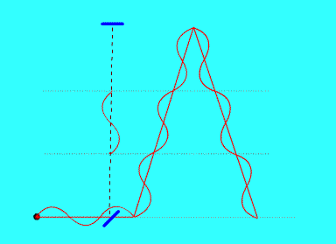
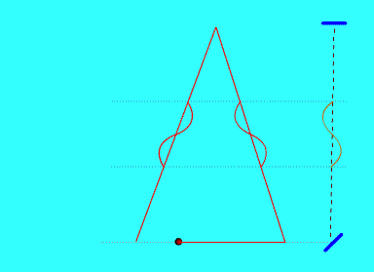
Electromagnetic wave equivalency along the Y axis
The apparatus measures the paths length in number of λ and the time in number of T. Using arbitrary units, such as m and t (SI), which are foreign to the measuring system, requires an ad hoc manipulation by means of the Lorentz transformation. This becomes superfluous when using the system proper units, since the Doppler effect acts on them
On the Y axis the wavelength λ appears contracted, such that
the number of λ along it is always equal to that along the actual beam path

Slide 14
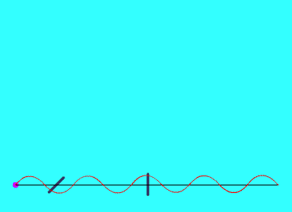
Electromagnetic wave equivalency along the X axis
On the inertial system the observed number of λ appears always equal to that of the actual beam path into space
(Observe that on the beam actual round trip there are 3 λ and the observed one there are also 3 λ)

Slide 15
Whatever the variation of the speed of the inertial system, the path of the reflected beam as seen on the proper system is invariant, even though the actual spatial path of the beam is different in each case. This incapacity to observe the effective path of the beam, and the fact of seeing instead an invariant deceptive path, makes inertial systems behave in an equivalent way
Due to the Doppler effect the wavelength along the interferometer arms varies in the same proportion as does the actual beam path length. This makes the number of wavelength along each arm to be invariant, and therefore the phase stays stiff

Slide 16
Comparison of the two approaches
Classical Model (Newtonian)
Natural units: λ and T
(system operating units)
Doppler effect
Length and time measured in terms of λ and T are invariant
The invariance of the measured length and time just relies on a metric based on λ and T as units
This metric does not need to be artificially manipulated by means of the Lorentz transformation. Instead it naturally obeys to the Doppler effect
Natural metric
Relativistic Model
Arbitrary units (SI): m and s
(foreign to those used by the set-up)
Lorentz transformation
The groundwork of special relativity require an illusive contraction of space and the dilation of time
The relativistic metric requires an ad hoc manipulation by means of the Lorentz transformation
The contraction of space is an unphysical effect, it is just a mathematical need of a counterfeit metric
Artificial metric

Slide 17
Conclusion
SRT invokes the contraction of space itself and the dilation of time
Instead our approach relies on the wavelength and the period, avoiding the use of an arbitrary metric and its manipulation through the Lorentz transformation
In fact, the Lorentz transformation derives from the Doppler effect and applies exclusively to λ and T, and not to space itself neither to time itself
We take the contraction of space as a fictitious effect, and as an irrational concept. It is just a mathematical joker that is void of any physical reality, and derives from the use of an artificial metric, foreign to that used by the measuring system
Inattention to the origin of the equivalency of inertial systems has promoted the absurd and irrational belief in space contraction induced by speed, which is as irrational as or even more than the old belief in geocentrism. It derives this time from a gauche direct mathematical reading of physical reality
The scarcity of a critical search for the physical cause of the equivalency of inertial systems, in favour of the sole search for a mathematic solution, has led to conceptual aberrations. A workable mathematical formulation does not necessarily imply an accurate apprehension of the actual physical reality
The cause of the constancy of the speed of light stands in the inaptitude of inertial observers to detect their proper motion, so they end up inexorably getting the intrinsic speed of light, which is constant
The major conceptual flaw of SRT arises from its assimilation of appearance to actual reality. Its inability to discern them has led to quite a few inner conceptual incoherencies and irrationalities, some of them pointed out as paradoxes

Slide 18
More information in the following links:
(1) First and second order electromagnetic equivalency of inertial systems, based on the wavelength and the period as speed-dependant units of length and time
(2) A causal approach to first-order optical equivalency of inertial systems, by means of a beam-pointing test-experiment based on speed-induced deflection of light
(3) Homepage

